Slide 1
IMPACT OF MIGRATION ON GDP
Presented by: Martha, Nithya, Donicia
July 2019

Slide 2
Assumptions
The analysis was conducted using two data sources:
Data Sources:
World Bank - GDP (US$) current report (last published 2018)
United Nations Migration Data (last published 2017)
Years presented are 2005, 2010, 2015 and 2017.
2017 was the last year published by the United Nations.
The top 20 countries were selected using the total number of migrants from country of origination over the years selected.
Countries are categorized within the World Bank GDP data and mapped to United Nations Migration Data.

Slide 3

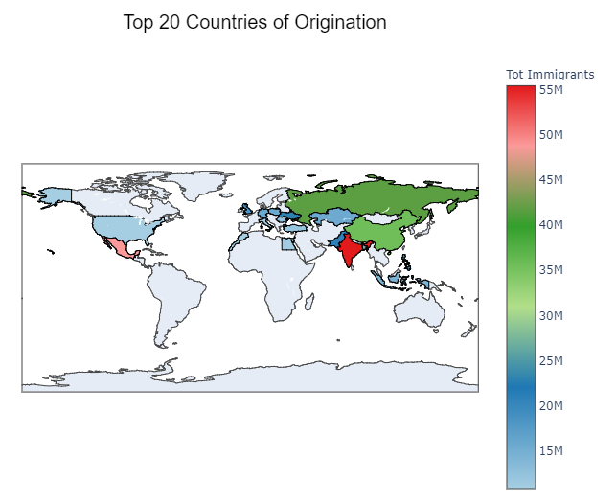
International migrant population
Outbound migration patterns by country over 12 years – 2005 to 2017

Slide 4

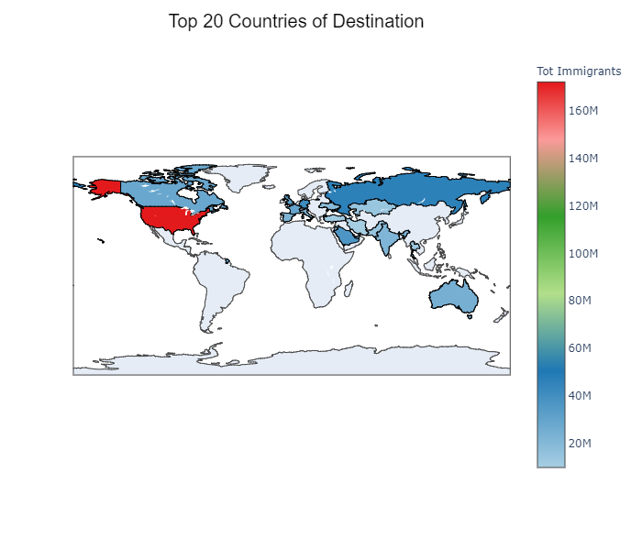
International migrant population
Inbound migration pattern for top 20 destinations over 12 years – 2005 through 2017

Slide 5
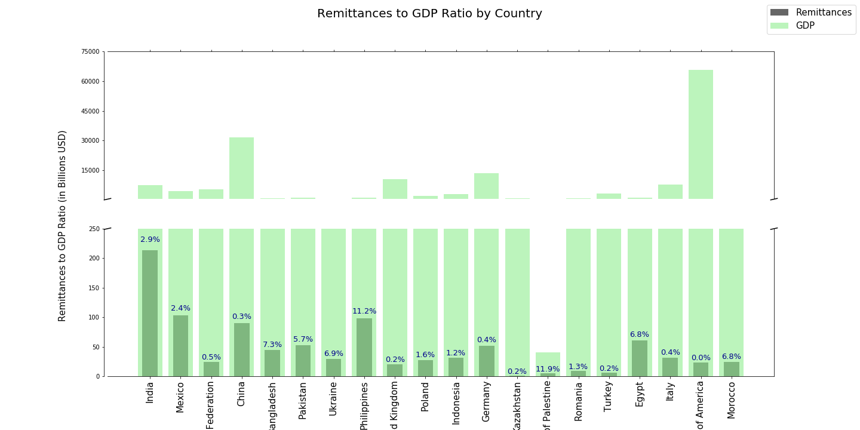
PERSONAL REMITTANCES TO GDP RATIO BY COUNTRY

Slide 6
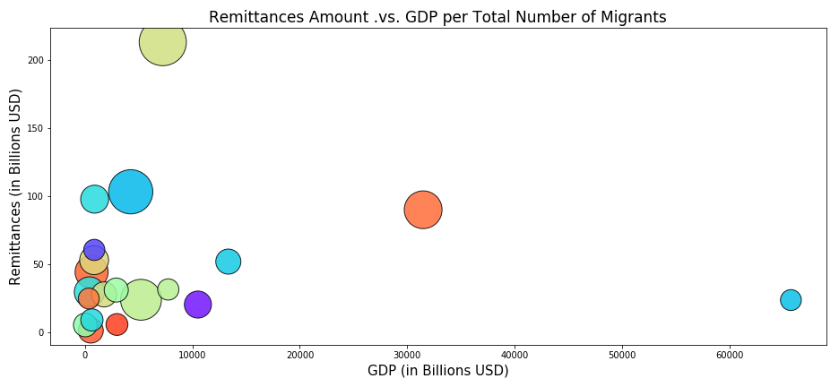
REMITTANCES AMOUNT VS GDP PER TOTAL NUMBER OF MIGRANTS
India
Mexico
TBF
TBF
United States

Slide 7
Remittances of low-income countries and migration ratio
Low Income
Lower Middle Income
Upper Middle
Income
High Income
India
Bangladesh
Pakistan
Ukraine
Philippines
Indonesia
State of Palestine
Egypt
Morocco
Mexico
Russian Federation
China
Kazakhstan
Romania
Turkey
United Kingdom
Poland
Germany
Italy
United States of America

Slide 8
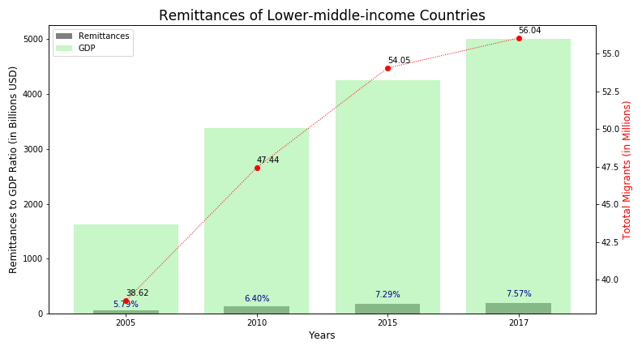
Remittances of low-middle income countries and migration ratio
This dataset presents remittances to GDP ratio and the migrant flow for the lower middle income countries over a period of 12 years.
India
Bangladesh
Pakistan
Ukraine
Philippines
Indonesia
State of Palestine
Egypt
Morocco
OBSERVATIONS:
Greater outbound migration from lower middle income countries.
Proportionate increase in remittances in the same period.

Slide 9
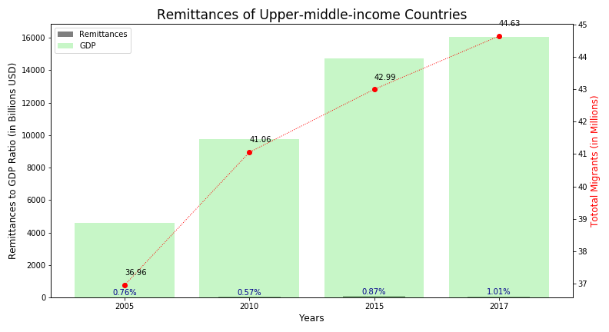
Remittances of upper-middle income countries and migration ratio
This dataset presents remittances to GDP ratio and the migrant flow for the upper middle income countries over a period of 12 years.
Mexico
Russian Federation
China
Kazakhstan
Romania
Turkey
OBSERVATIONS:
Outbound migration is high.
Remittance is moderate. Mexico (2.4%) is one of the primary countries followed by Romania (1.3%)driving the increase in remittances. The rest contribute between (0.2-05%).

Slide 10
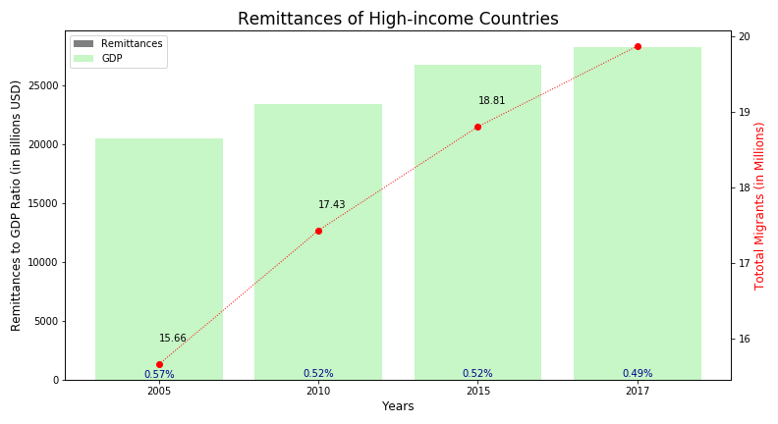
Remittances of high income countries and migration ratio
This dataset presents remittances to GDP ratio and the migrant flow for the high income countries over a period of 12 years.
United Kingdom
Poland
Germany
Italy
United States of America
OBSERVATIONS:
High Income countries show some outbound migration to other countries
The remittance levels are very low.

Slide 11
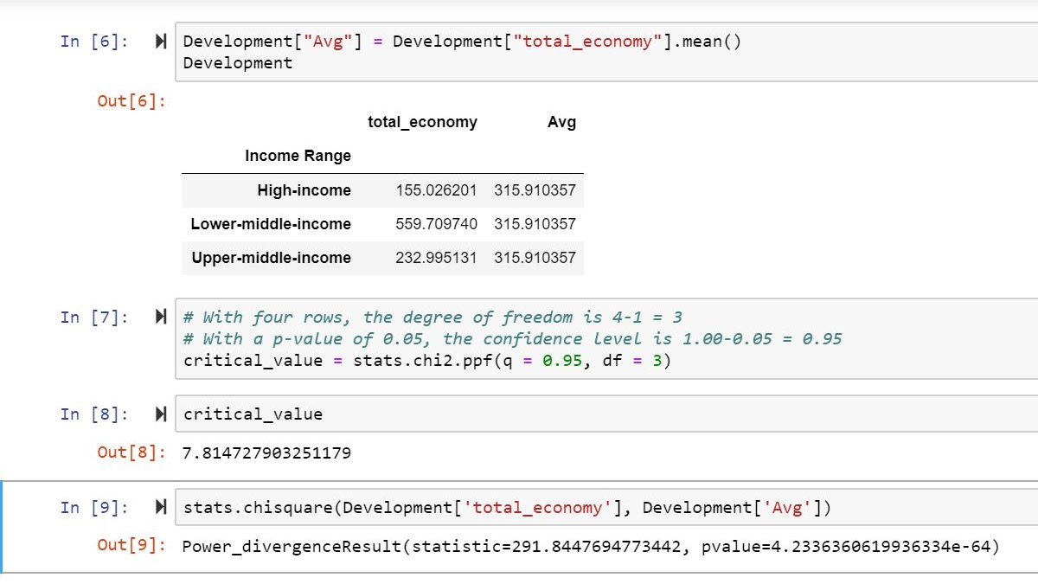
CHI-SQUARED distribution
Is there a relationship between income of a country and
the personal remittances received by them?
OBSERVATIONS:
Null hypothesis - Regardless of income level they will send the same amount of remittances back. P-value is a low value In this dataset we understand that the Null Hypothesis is False. The income level of inbound countries really affects the amount of money sent back.

Slide 12
CONCLUSIONS
Immigration to countries with high GDP has gradually increased over the past 12 yrs.
Immigrants from lower income countries are the highest contributors to remittances at origin.
Despite high rate of migration from upper middle income countries, remittances are nominal (notably less when compared to lower income countries)
Gradual growth in outbound migration from higher income countries have negligible co-relation to remittances.
GDP has continued to grow in High income countries with the in-flow of immigrants.

Slide 13
Technical aspects
Sources of Data:
United Nations - Department of Economic and Social Affairs. International Migration (https://www.un.org/en/development/desa/population/migration/data/estimates2/estimates17.asp)
World bank – Economy and Growth (https://data.worldbank.org/topic/economy-and-growth )
Cleanup Process
Data in XLS or CSV format. We uses Excel to cleanup logos and headers
Once all data was in CSV format we manipulated it in Pandas
Migration Data:
Using a country catalog, we filtered the migration and economic data to drop any information NOT related to countries (regions, classifications, etc.) and obtained countries’ additional information (region, development level, income level)
Format in migration data did NOT help manipulation, so it was changed: from columns to rows, ellipses, commas in the numbers
Top countries (origin and destination) were found and CSV produced for plotting
Economic Data:
Using a country catalog, we filtered the migration and economic data to drop any information NOT related to countries (regions, classifications, etc.)
Countries with missing economic data (GDP or remittances) had to be dropped
Surprises: Top 20 countries of origination, flow between India and Pakistan, no low income countries in the top 20 list
Problems: not the same countries in both sources, format in migrant information, country names

Slide 14
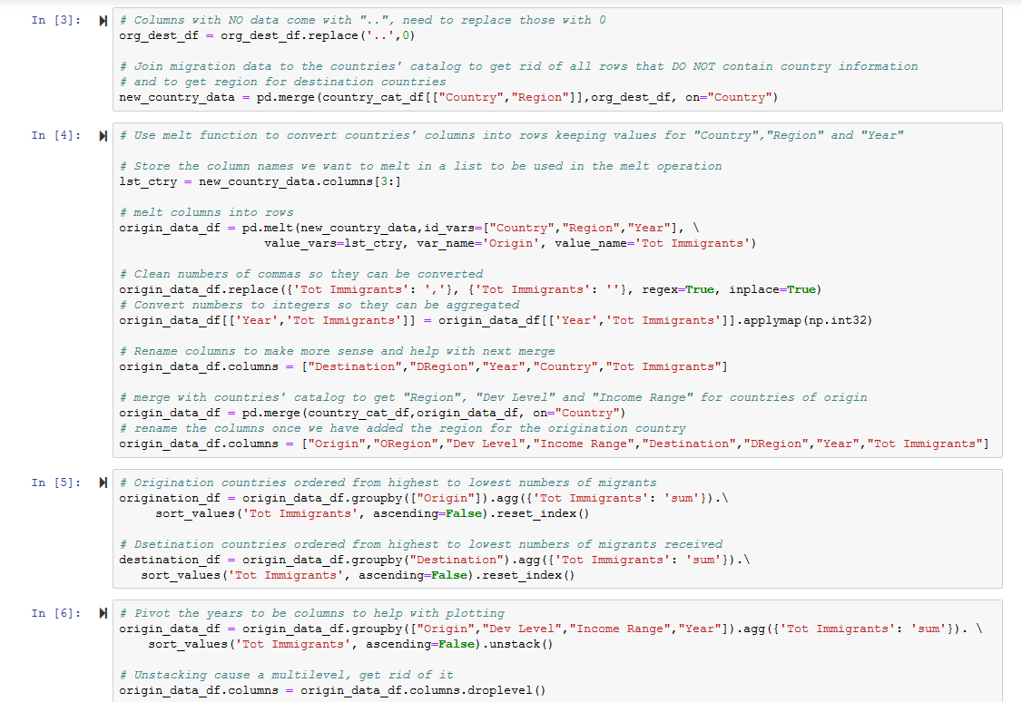

Slide 15
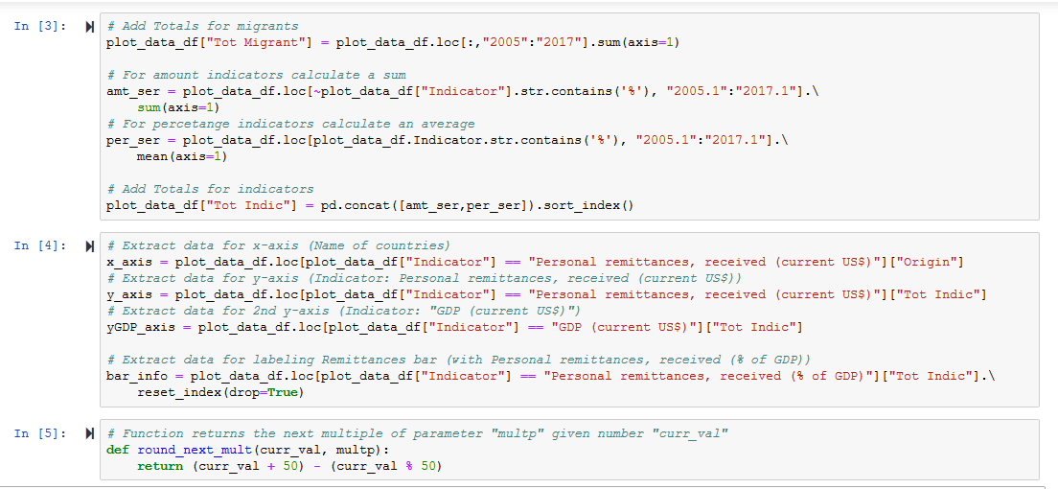

Slide 16
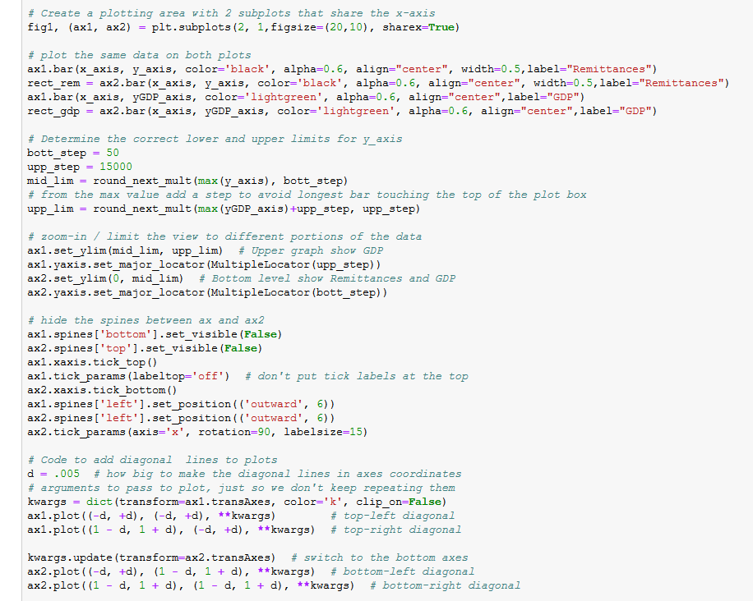

Slide 17


